Slide 1

Medical Insurance Cost Drivers and Policy Strategy
An Analysis of Insurance Charges, Risk Factors, and Demographic Patterns
Presented by: Eyob Hailemichael Woldeyohanis

Slide 2

CHAPTER 1: PROJECT FOUNDATION
Project Overview & Dataset Summary
Project Goal
Dataset Snapshot
Analyze insurance data to uncover insights that guide policy design, cost reduction strategies, and targeted customer interventions.
Kaggle dataset with 1,338 rows and 10 columns.
Key Features: Smoker, Age, BMI, Charges, Region, Children.
No missing data after initial cleaning.

Slide 3


CHAPTER 2: EXPLORATORY DATA ANALYSIS
Feature Engineering for Deeper Insight
Initial data exploration involved loading, checking structure, and connecting to MySQL. Crucially, we created new categorical features to enhance analysis.
Age Group
BMI Group
Categorized customers into Young Adult, Adult, Middle-aged, and Senior segments.
Grouped BMI into Underweight, Normal, Overweight, and Obese categories.
Children Categories
Segmented households by number of dependents (No/One, Few, Many).

Slide 4

KEY FINDING 1
Smoking: The Primary Cost Driver
Smoking status is the single most significant predictor of insurance charges, creating a massive financial disparity.
$32,050
$8,690
Smoker Average Charge
Non-Smoker Average Charge
Average charge for a customer who smokes.
Average charge for a customer who does not smoke.

Slide 5
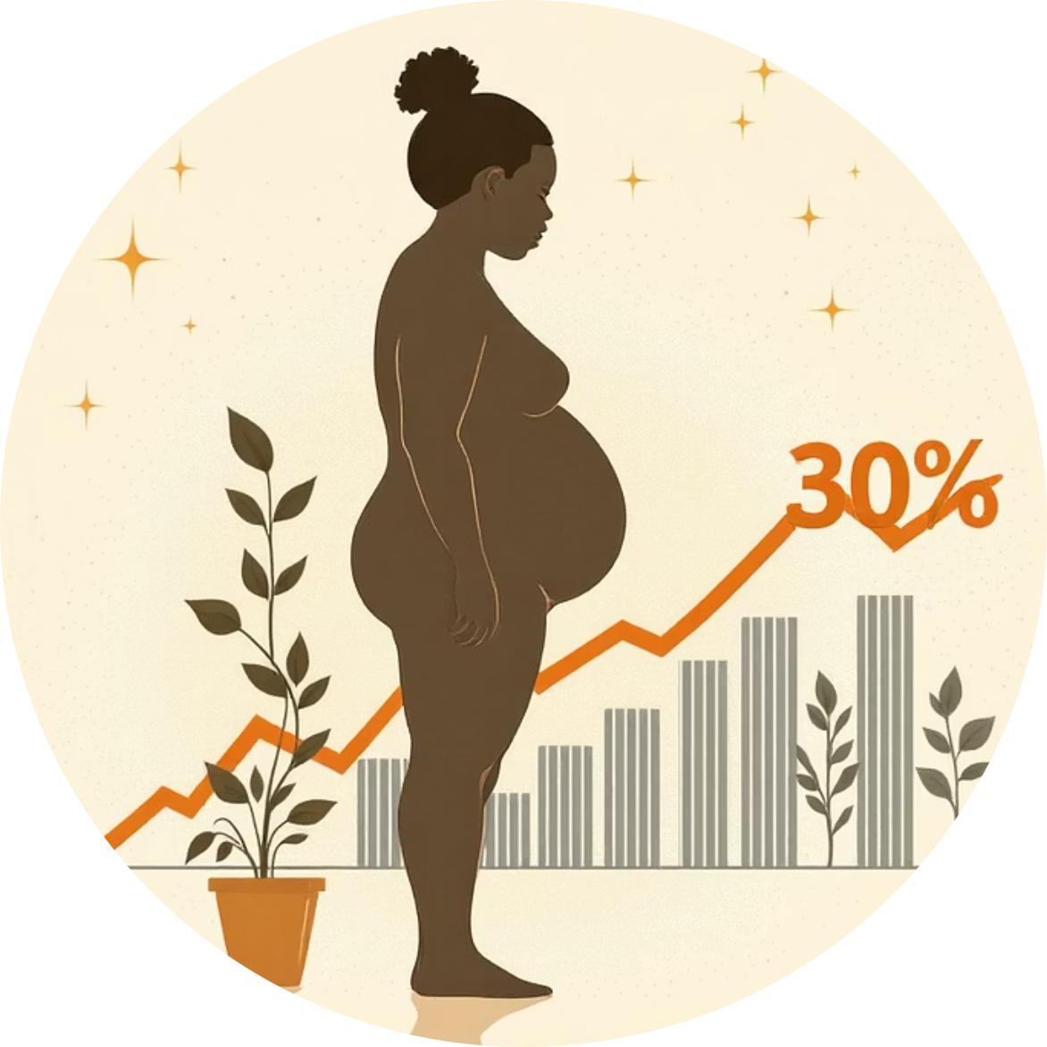



KEY FINDING 2
Impact of BMI and Age on Charges
Charges increase significantly with both age and BMI, highlighting the financial risk associated with weight and maturity.
Obese Patients
Normal BMI Patients
Average charge: $16,962.40
Average charge: $11,407.83
Age Correlation
Age is strongly correlated with higher charges, especially in high-cost claims.

Slide 6




High-Cost Claims Profile
Analysis of claims over $20,000 reveals a clear risk profile dominated by smoking status and high BMI.
Smoker Status
BMI Group
Smokers are overwhelmingly represented in the high-cost claim bracket.
Obese customers contribute disproportionately to the highest insurance costs.
Age Group
Middle-aged and Senior customers drive the majority of high-cost claims.

Slide 7


FINANCIAL OPPORTUNITY
Projected Cost Reduction Potential
Targeted health interventions offer significant financial returns by mitigating the highest risk factors.
$878,176
Smoking Reduction
Projected savings if smoker prevalence drops by 10%.
$282,423
BMI Reduction
Projected savings if Obese customers reduce BMI by 5%.

Slide 8
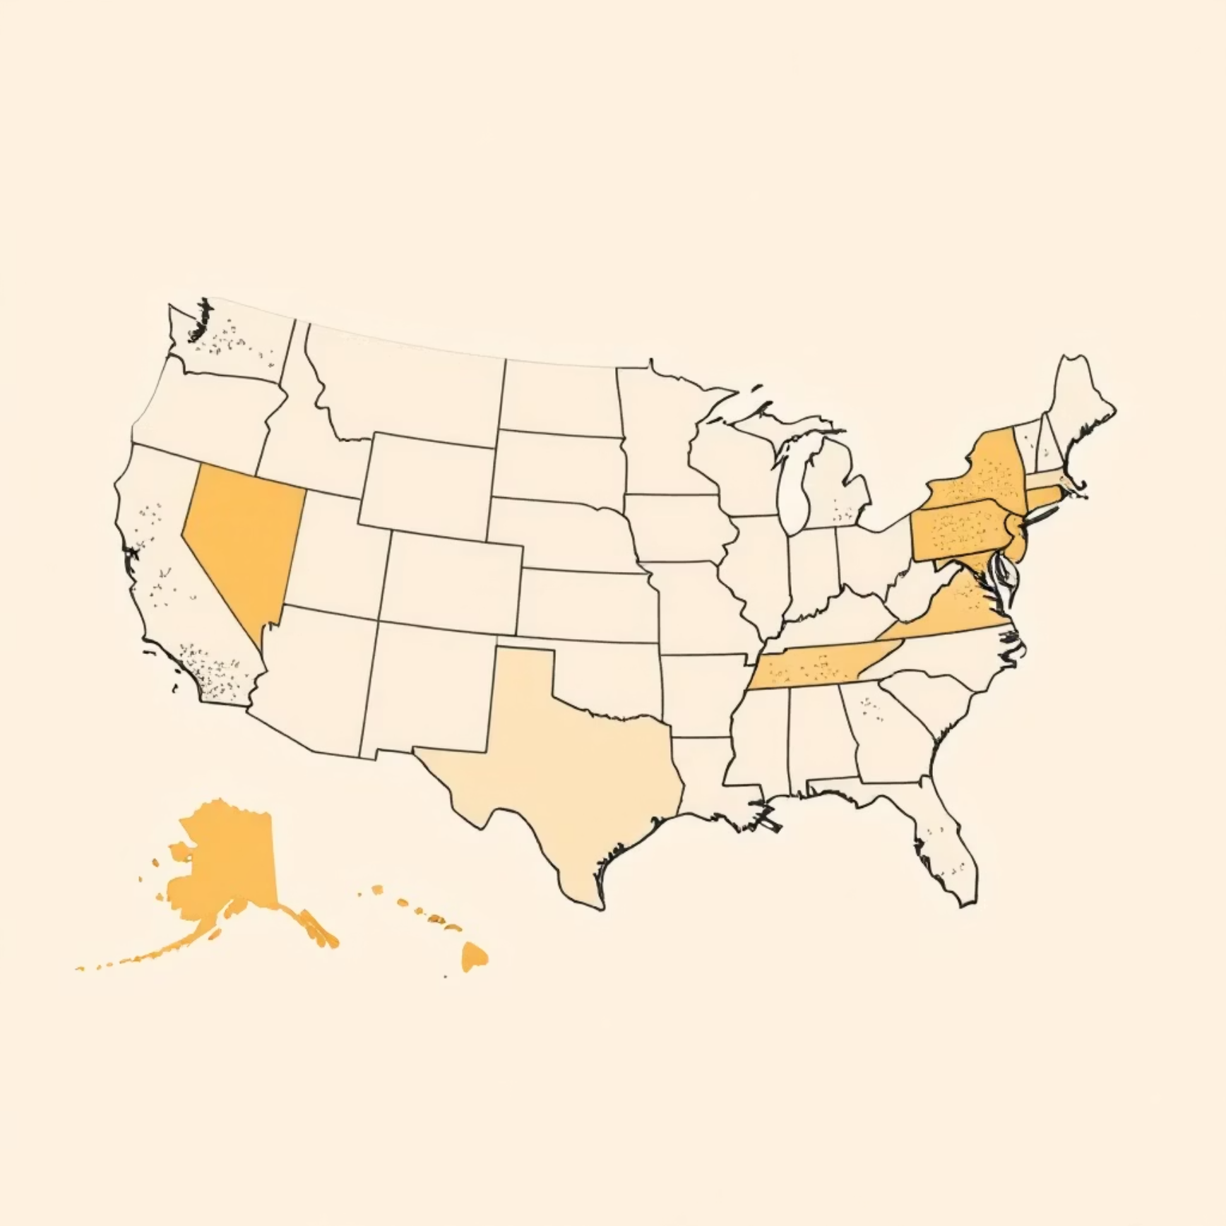
ADDITIONAL INSIGHTS
Regional and Family Dynamics
Regional Cost Variation
Children Categories Effect
High-cost claims are concentrated in specific regions, suggesting geographic factors influence risk.
The number of children in a household also impacts average charges, varying by region.
No/One Child
12000
Few Children
13500
Many Children
14200

Slide 9




STRATEGIC IMPERATIVES
Core Business Recommendations
Smoking Cessation Programs
Implement aggressive health campaigns and incentives to reduce smoker prevalence.
Targeted BMI Wellness
Launch wellness programs specifically for high-risk (Obese) customer groups to reduce BMI.
Data-Driven Pricing
Adjust premiums based on demographic, BMI, and smoking status insights for risk-adjusted pricing.

Slide 10

Next Steps: Actionable Policy Design
"By focusing our resources on the primary cost drivers—smoking and high BMI—we can achieve significant financial savings and improve customer health outcomes."
Q4 2024
Finalize budget for targeted wellness and cessation programs.
Q1 2025
Roll out new risk-adjusted policy structures based on analysis.
Q2 2025
Begin tracking and reporting on projected cost reduction metrics.

